Slide 1
Opioid Overdose
Prevention System
Madhumathi Prakash
Vignesh Murali
Pooja Pingle

Slide 2
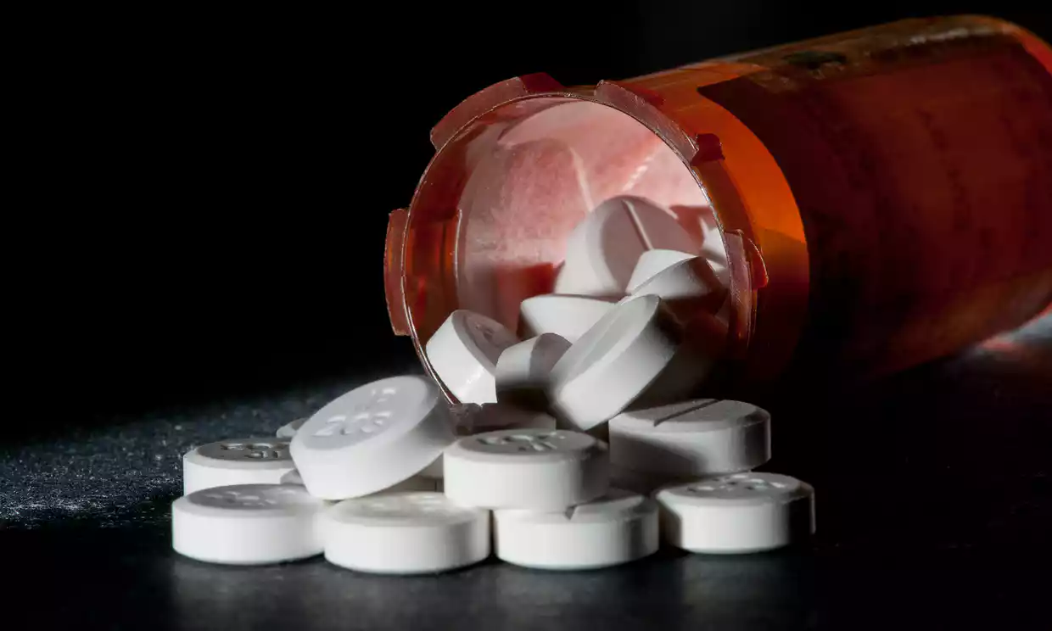
Problem Statement
Opioid abuse is biggest public health concern in the United States today.
Opioid overdoses are the leading cause of accidental deaths in the country.
The government spends almost $80 billion dollars a year to combat this problem.
The opioid crisis is generally dealt with after a patient is addicted to a substance.
Notes:
64,000 deaths per year
$80 b funded for clinics and treatment

Slide 3
Approach
Globally solve this issue
Aiding doctors in preventing opioid addiction among patients by suggesting alternative methods of treatment.
Identify patients who are on the verge of addiction and prescribe opioid reversal medication.
Monitoring the frequency of prescriptions written by doctors which enables hospitals to take necessary action.
Helps state and national authorities keep track of opioids and enables them to rethink the legal status of these drugs.

Slide 4
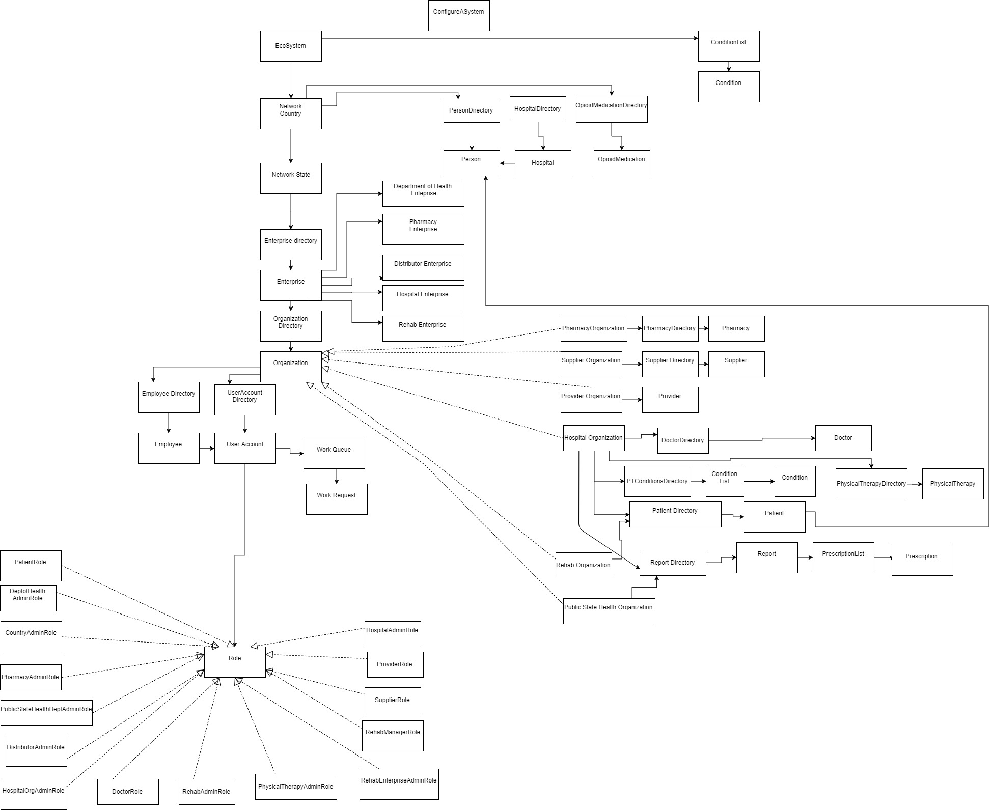
Object Model

Slide 5
Use Cases

Slide 6
Major Use Cases
System Administrator
Create and Manages Countries
Create and Manages Country User Accounts
Country Administrator
Manages State Networks
Create and Manages Enterprise Administrator
Create and Manage State Level Enterprises
Hospitals
Add doctors and patients.
Patient
Book appointment with doctor.
Doctor
Diagnoses patient depending on the intensity condition or status of addiction.
Sends a patient to rehab,physical therapy depending on the condition.
Request a refill of medication prescribed.
Cancel appointment
Create and Manage Opioid Medication Available in the country.
Monitor doctor violations.
Create patients and doctors.
Set Physical therapy conditions.
May accept or reject, please for refills from the patient.
Or write prescriptions for opioids sent to the pharmacy depending upon the diagnosis

Slide 7
Major Uses Cases (Continued)
Pharmacy
Receives the prescription from the doctor.
Obtains opioids from the provider and supplies it to the patient.
Public Health Organization
Can view analytical graphs based on several conditions.
View state level statistics
Rehab
Addicted patients sent by the doctor are treated here.
View Country level statistics

Slide 8
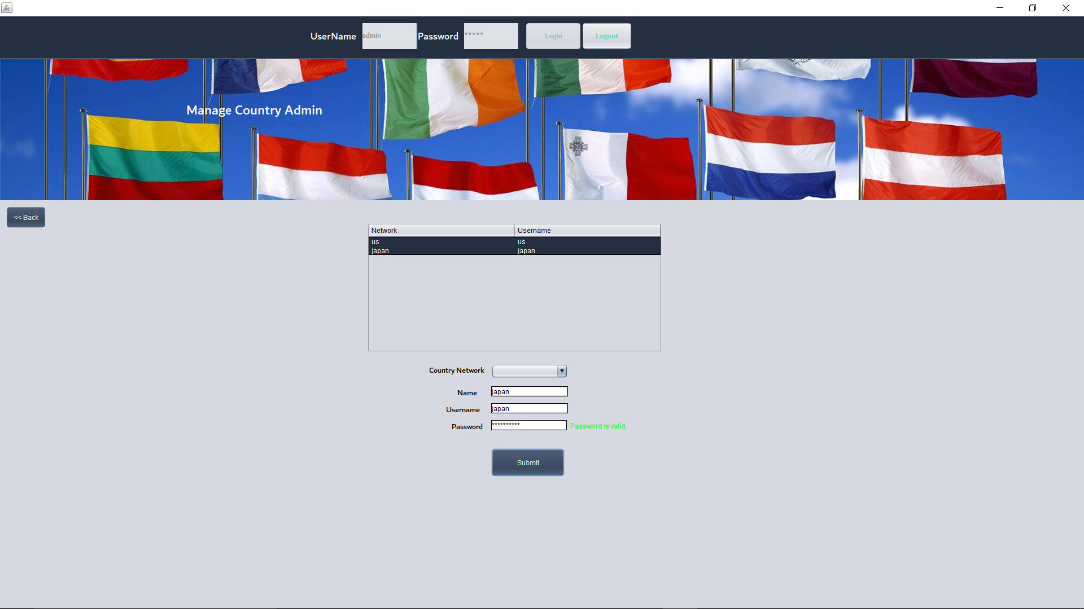
System admin creates and adds countries

Slide 9
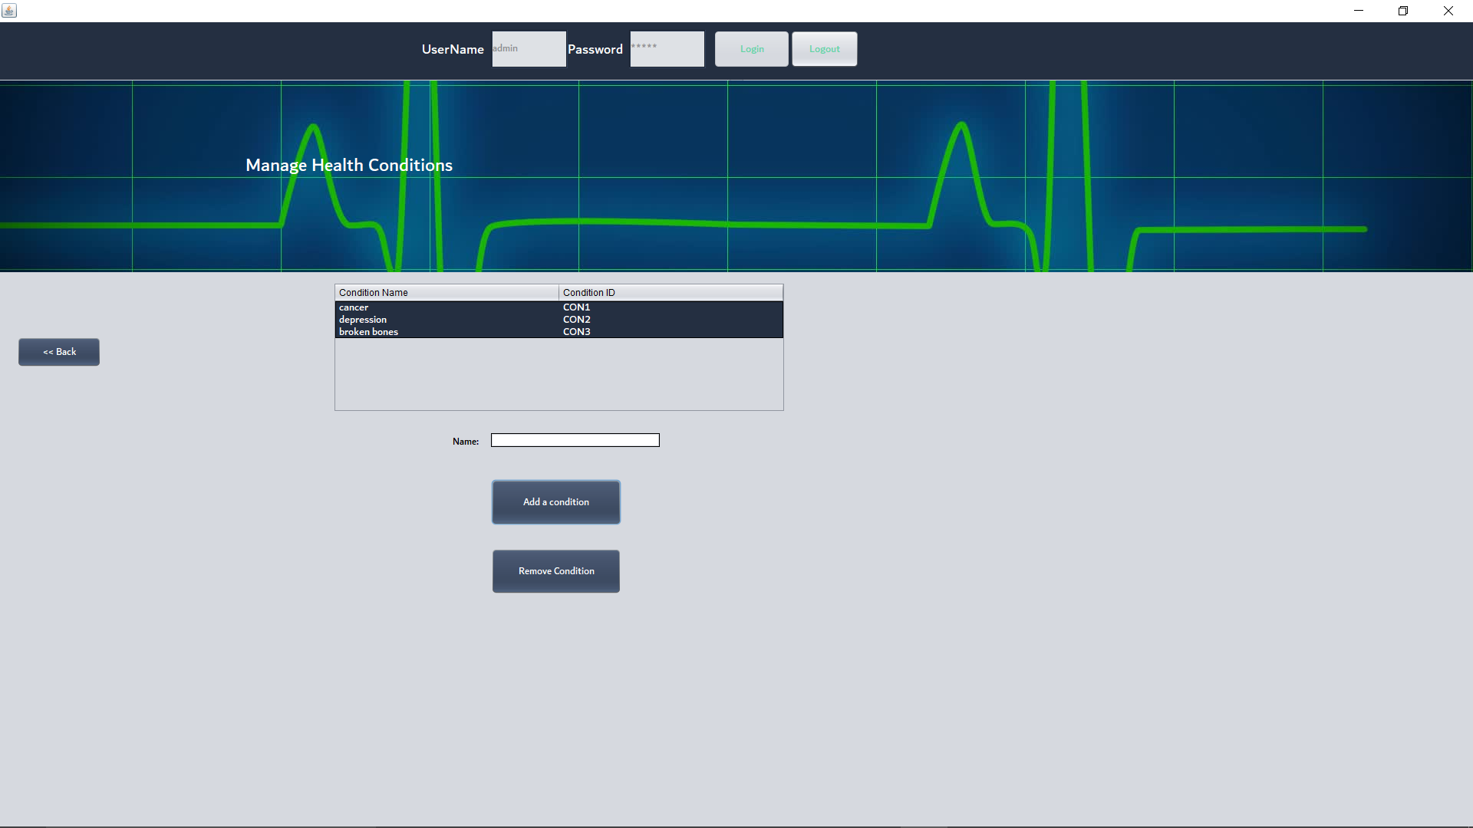
System Admin Adds conditions/Illness

Slide 10
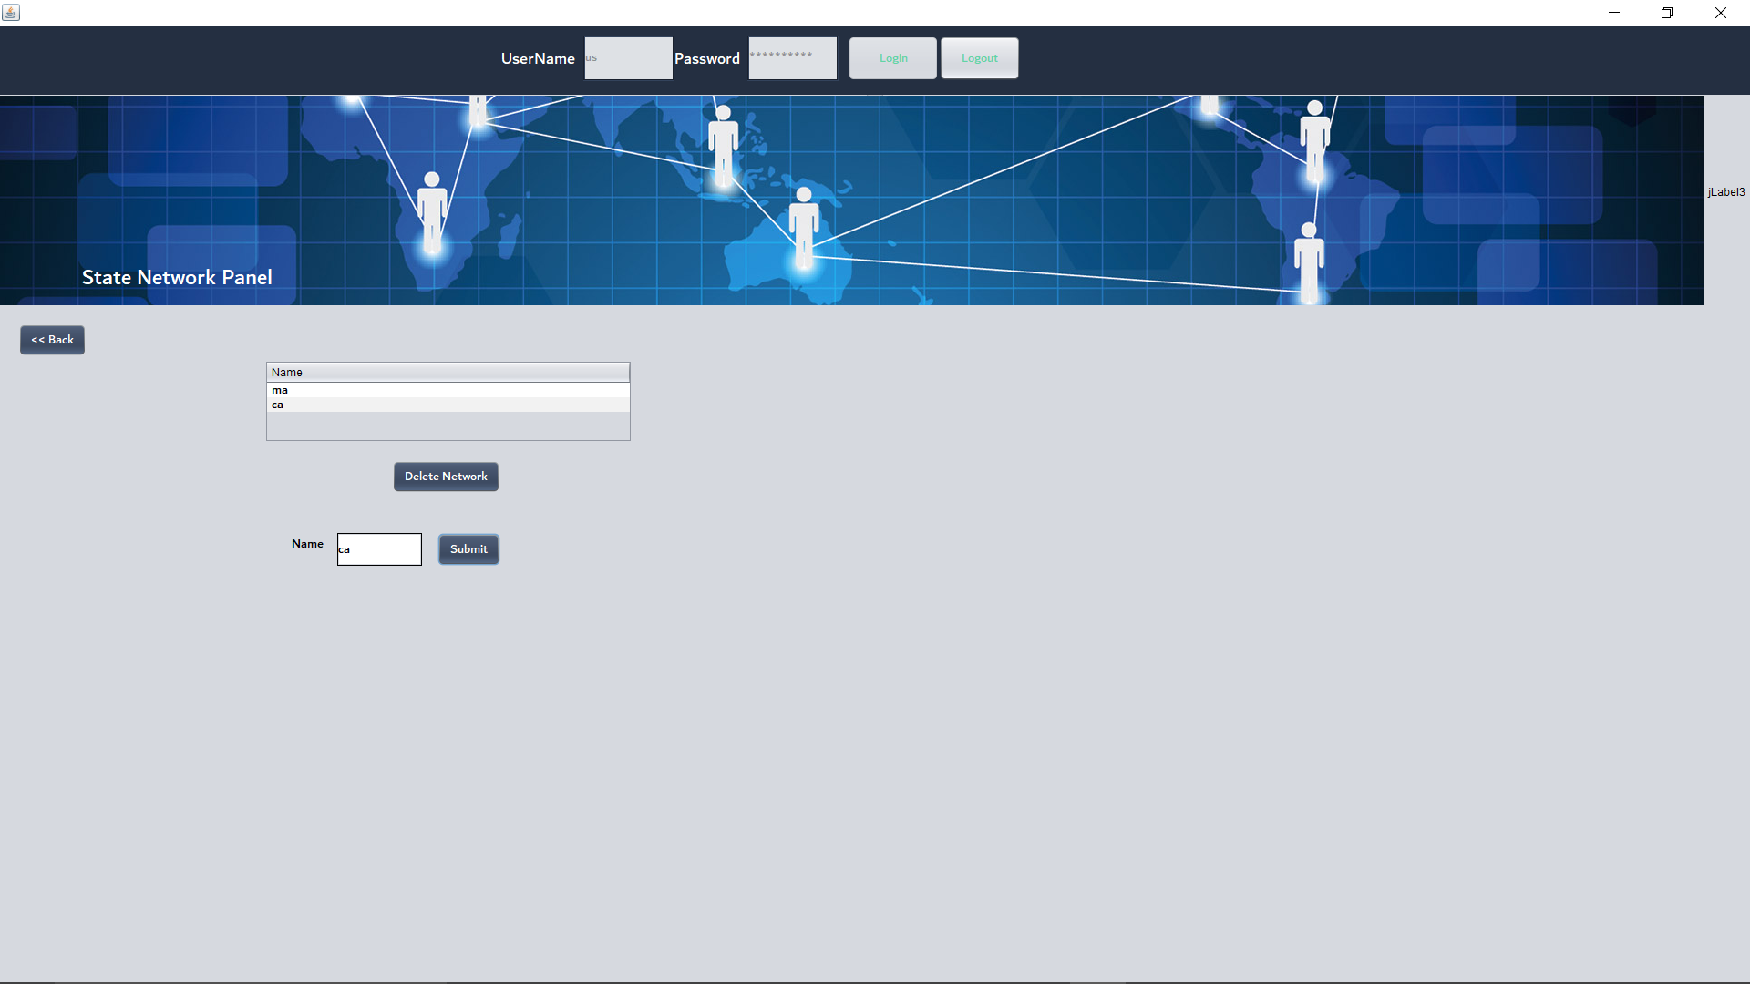
Manage State Networks

Slide 11
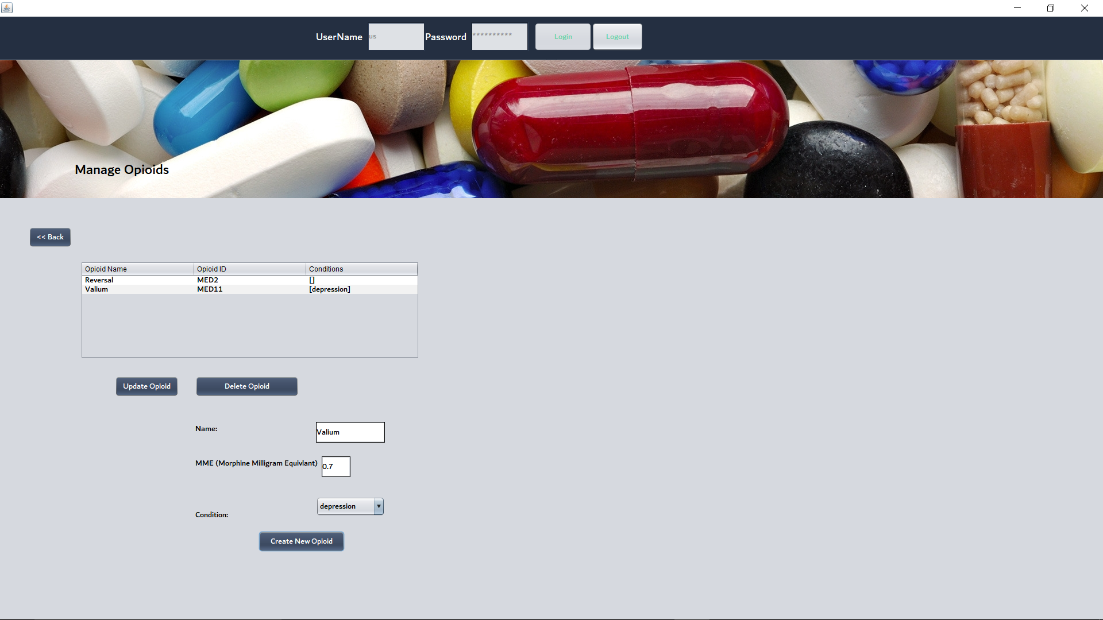
Each country adds opioid list and associates to condition

Slide 12
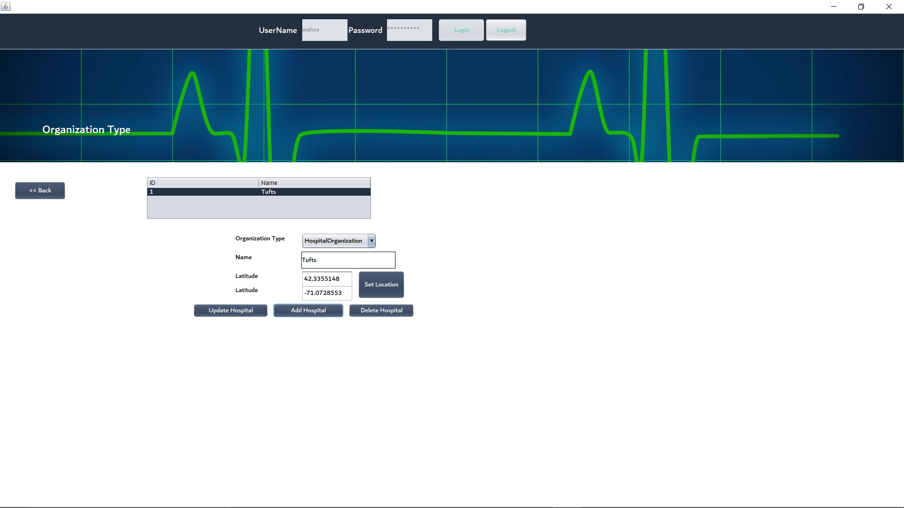
Each Hospital Enterprise creates hospital and sets location

Slide 13
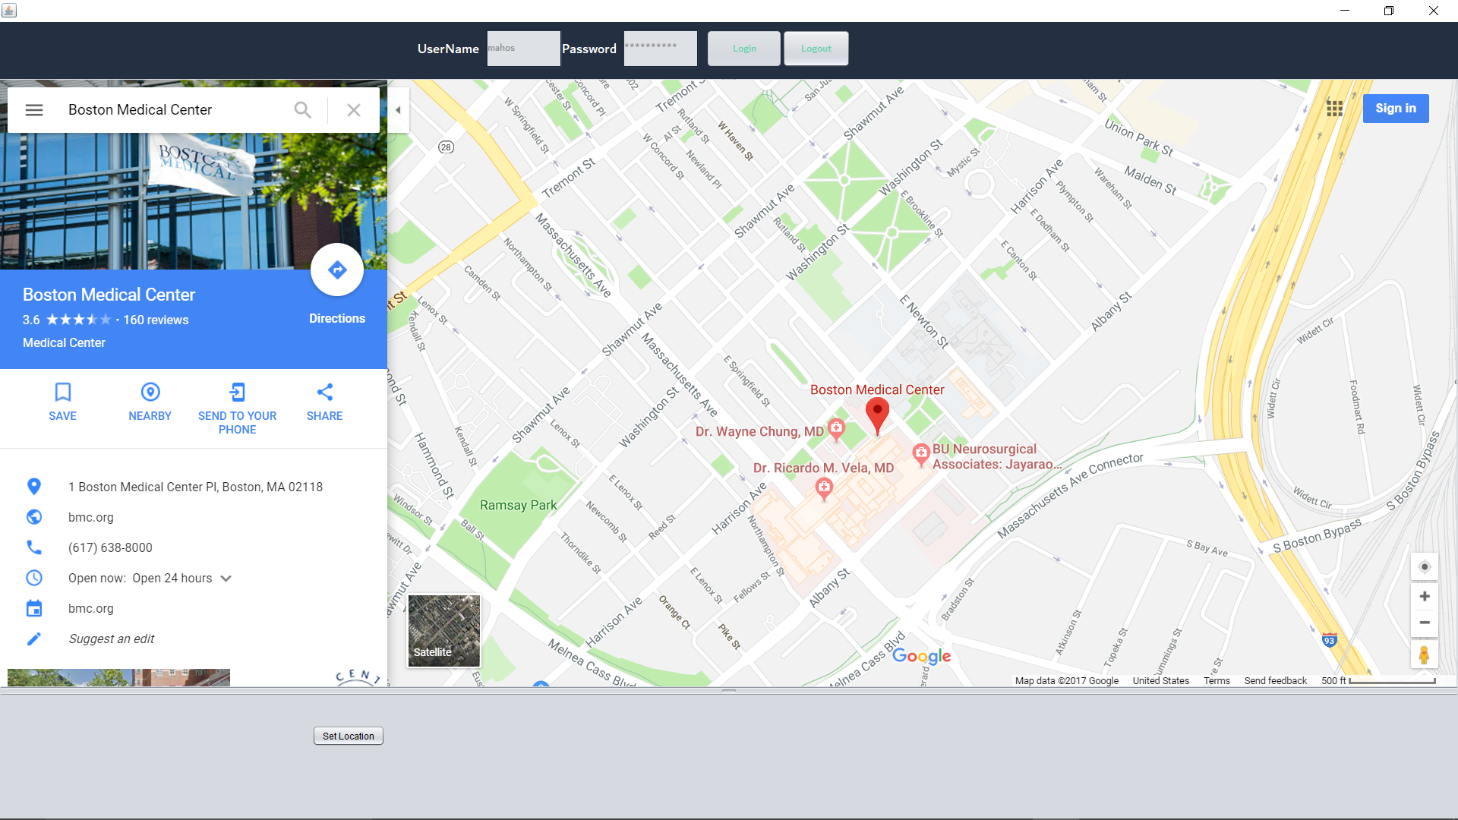
Each Hospital Enterprise creates hospital and sets location(Continued)

Slide 14
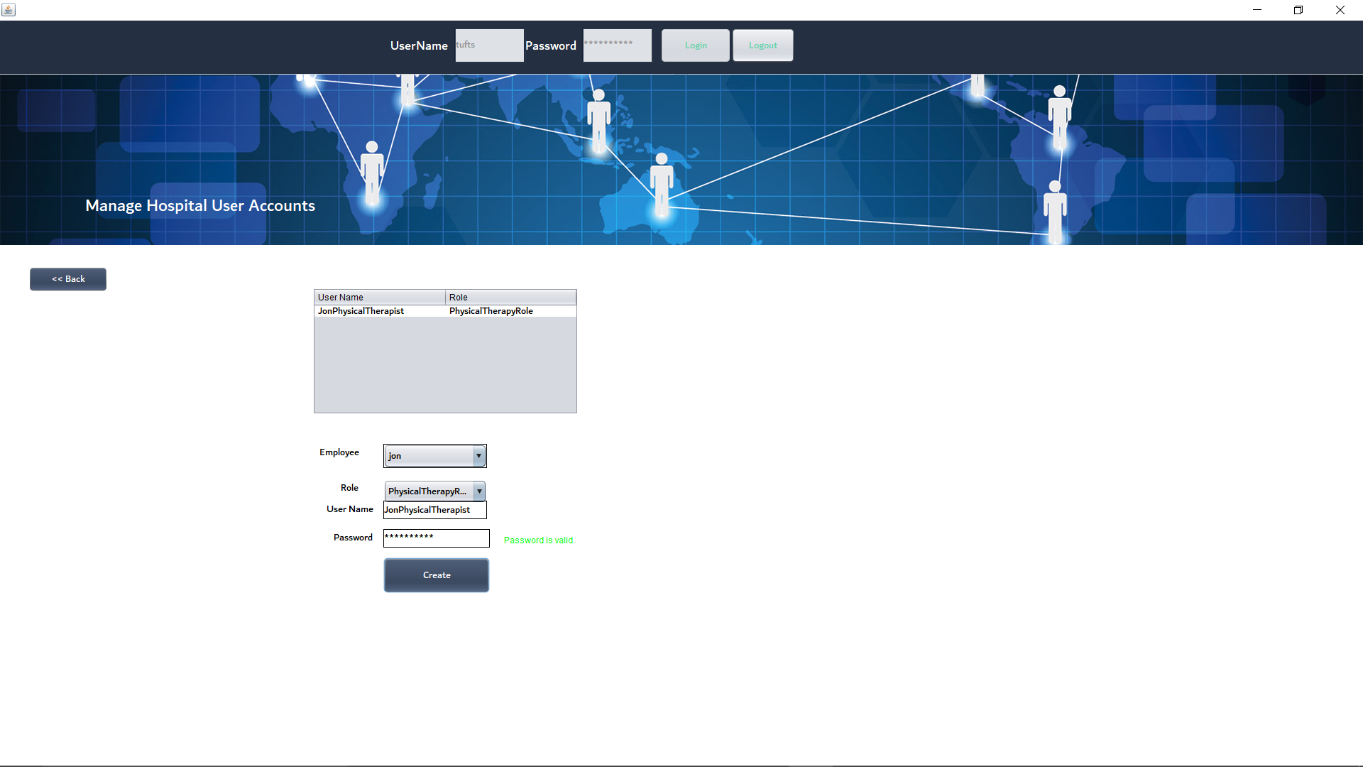
Each Hospital Organization creates Physical Therapists

Slide 15

Each Hospital Organization creates Doctors

Slide 16
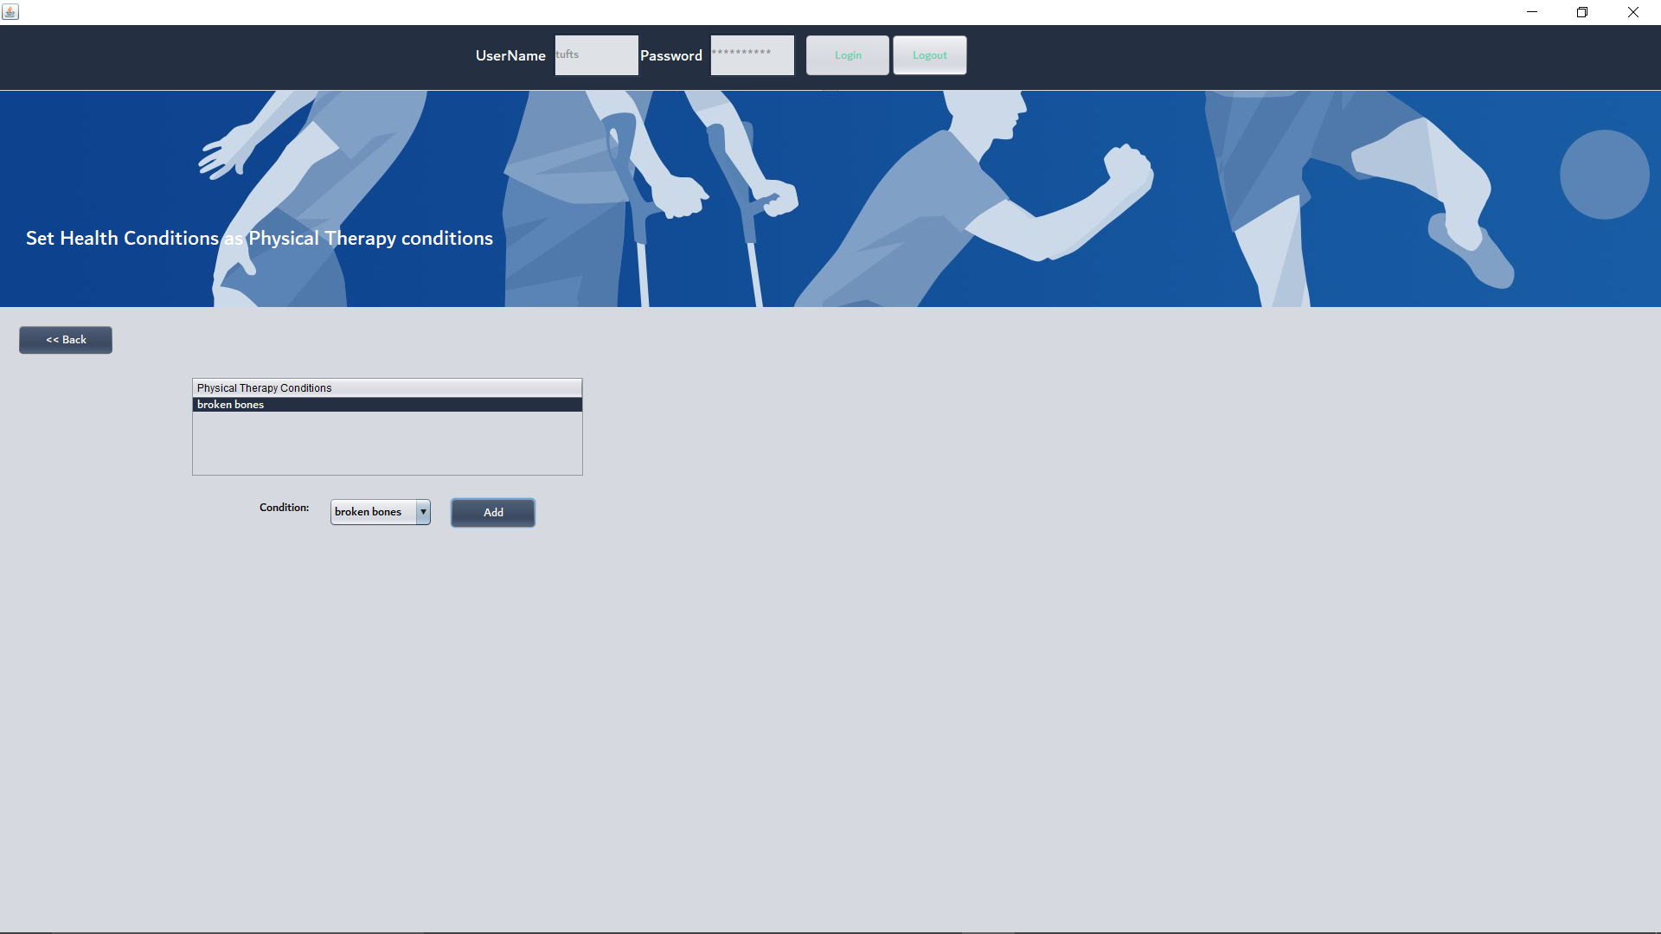
Each Hospital Organization creates Conditions that are valid reasons for physical therapy

Slide 17
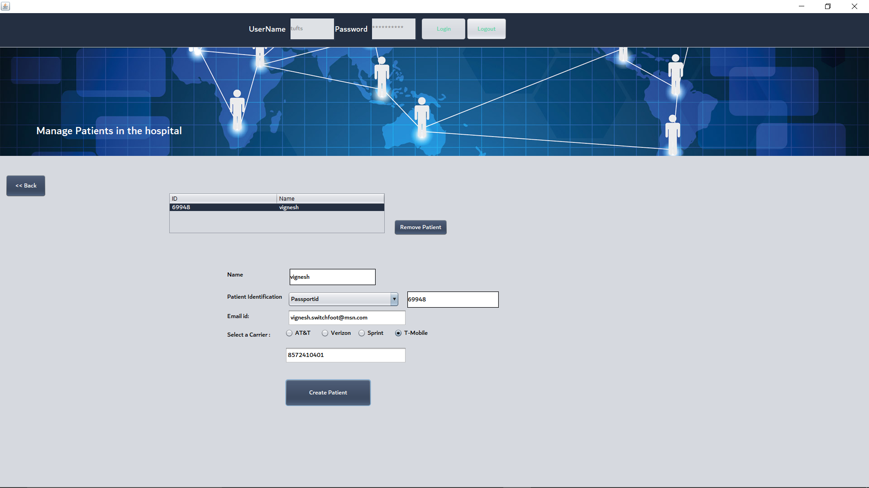
Hospital Organization creates patient

Slide 18
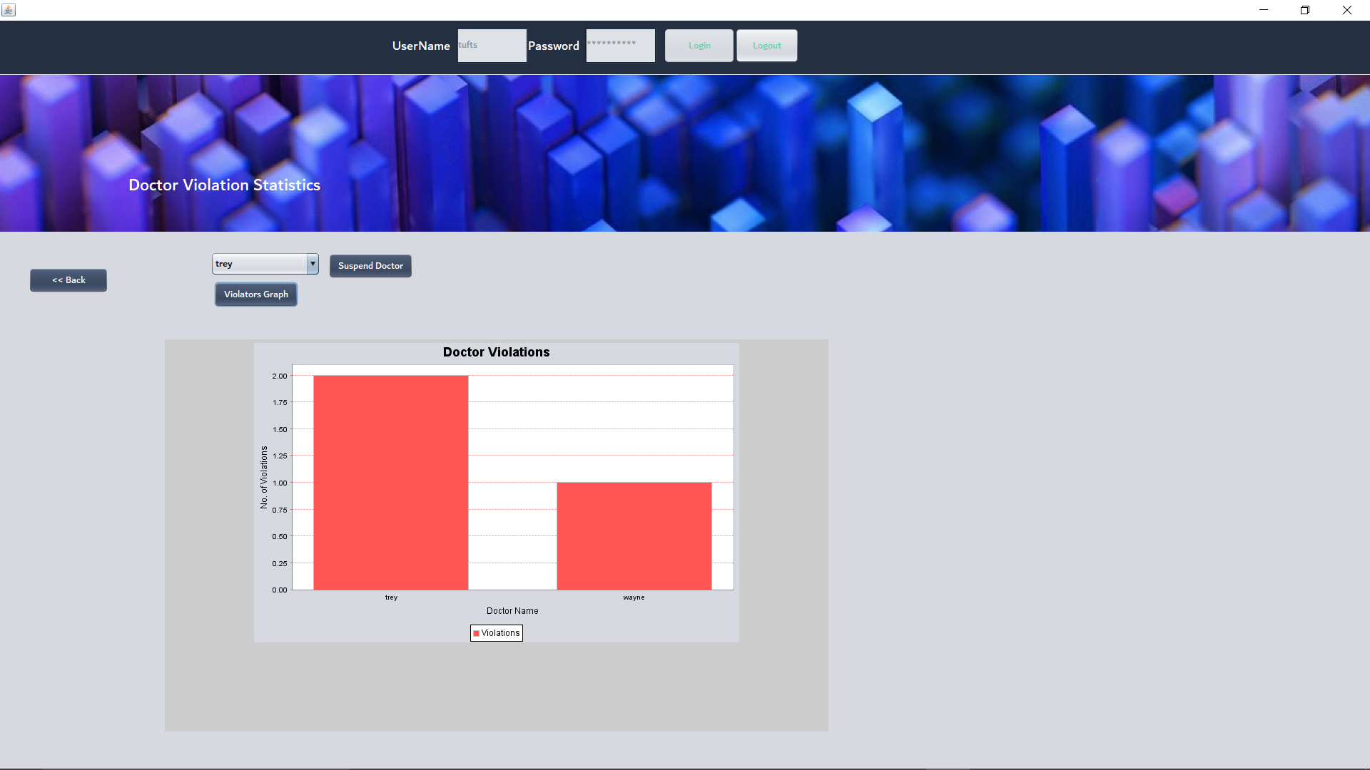
Hospital Views Statistics on Doctor Violations

Slide 19
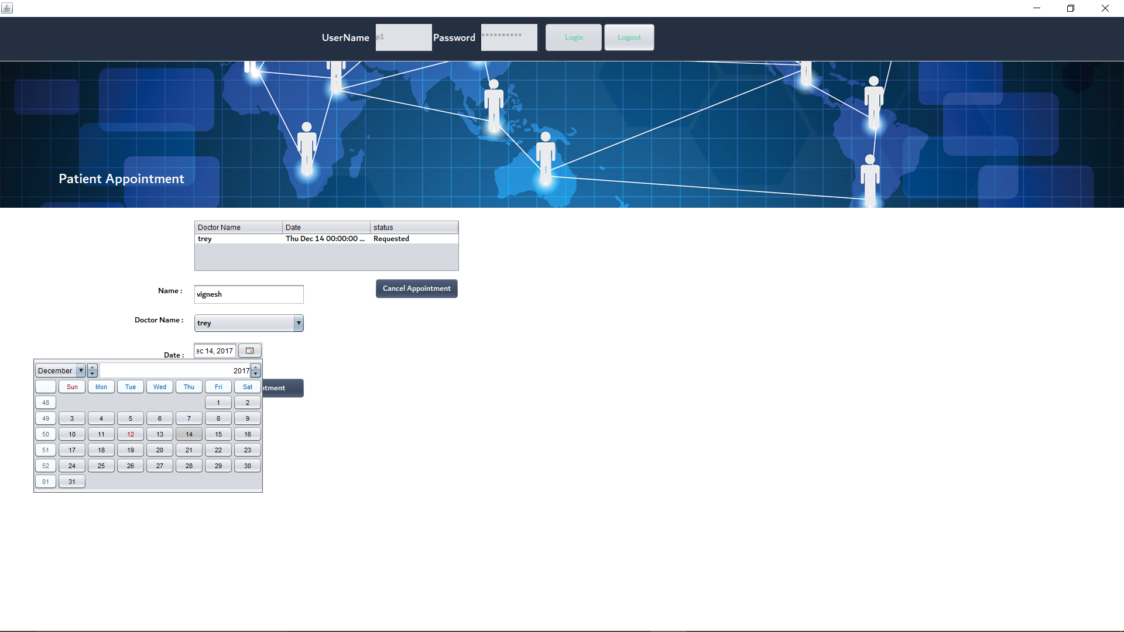
Patient can request appointment

Slide 20
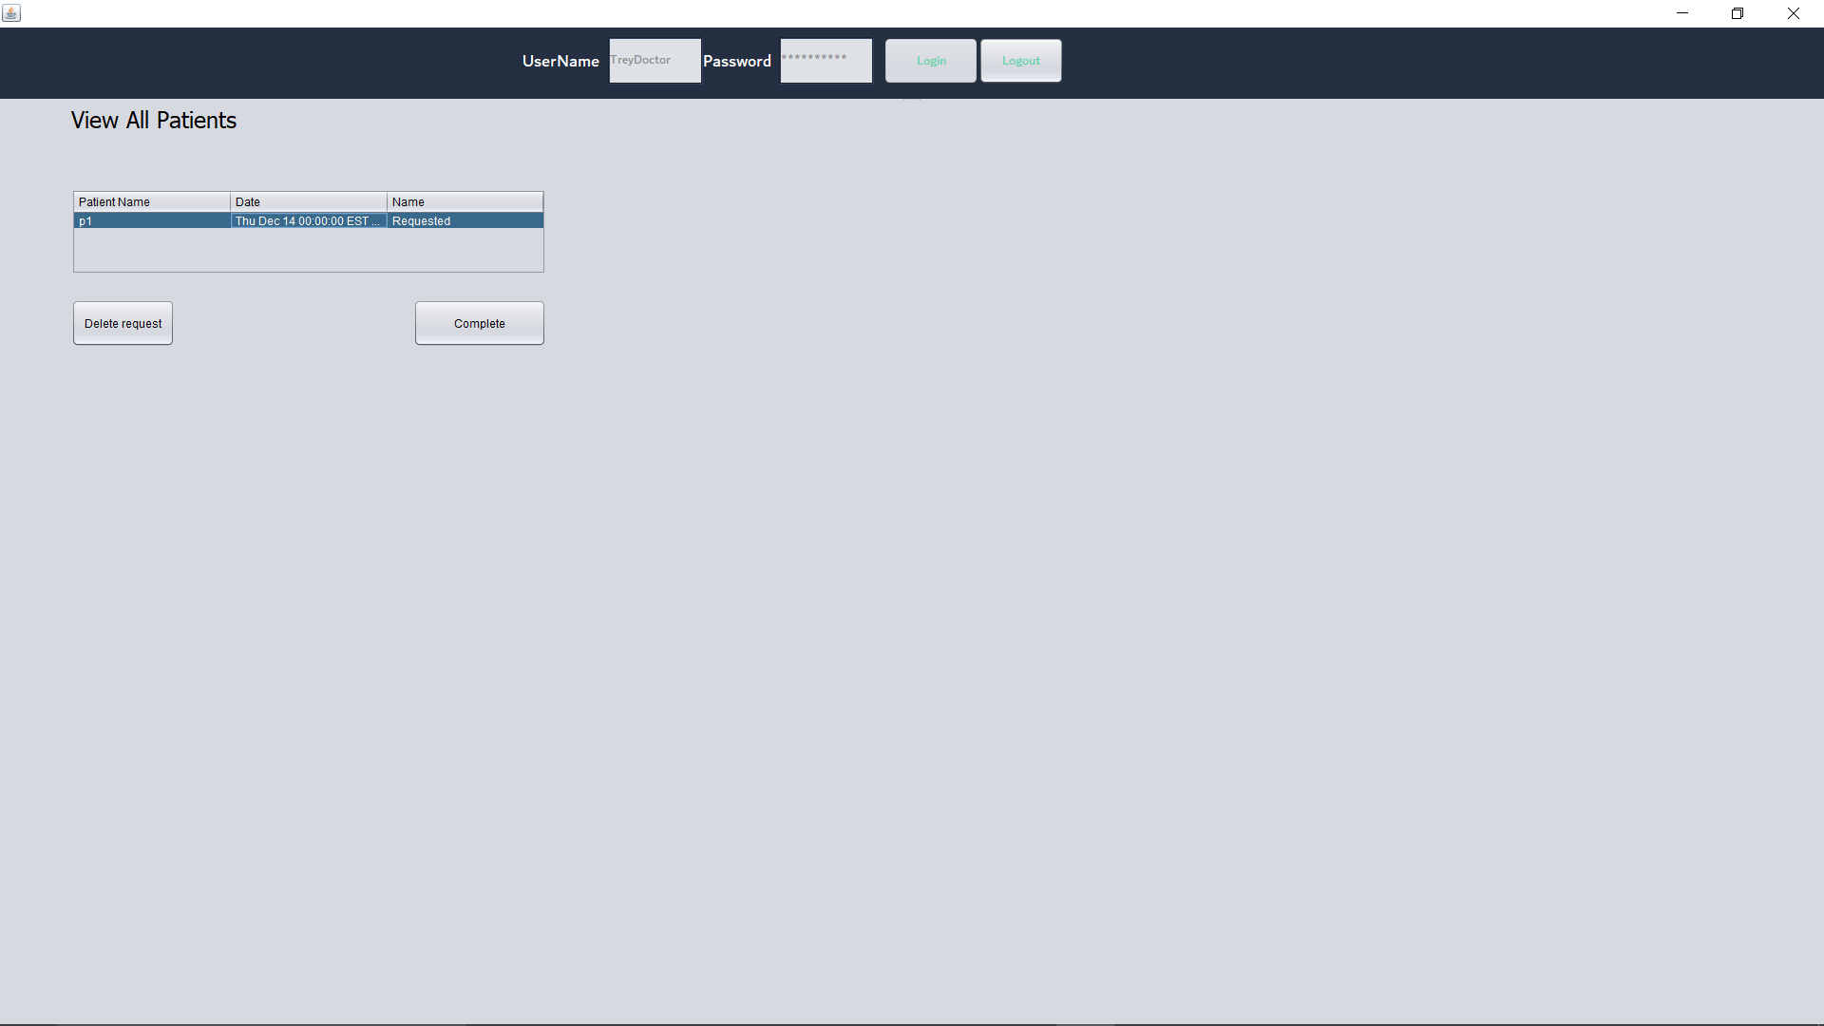
Doctor can view the list of patients and timings

Slide 21
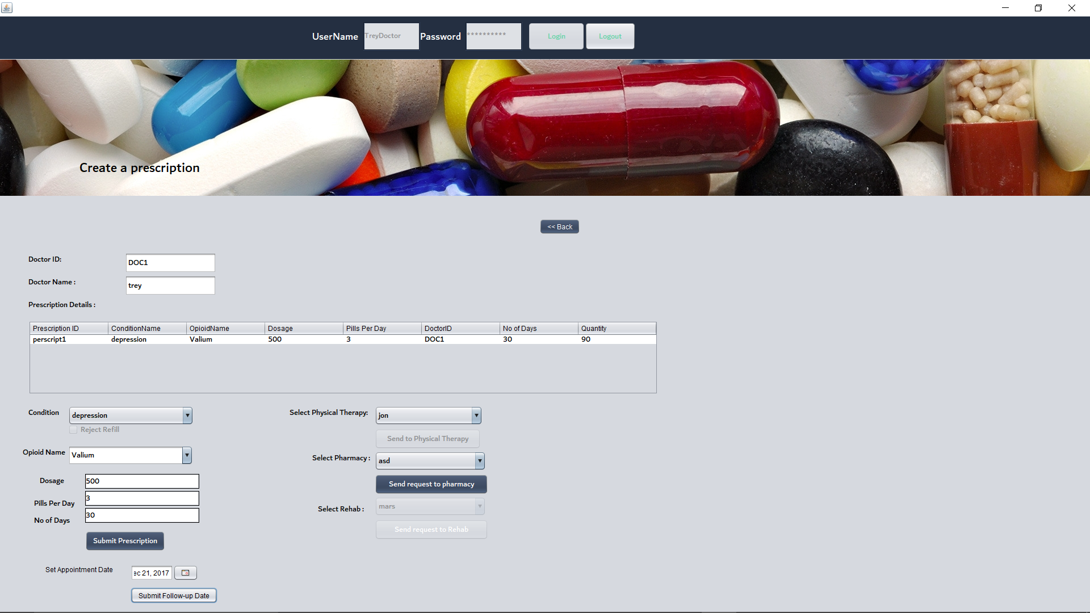
Doctor checks multiple conditions (Decides what action to take)

Slide 22
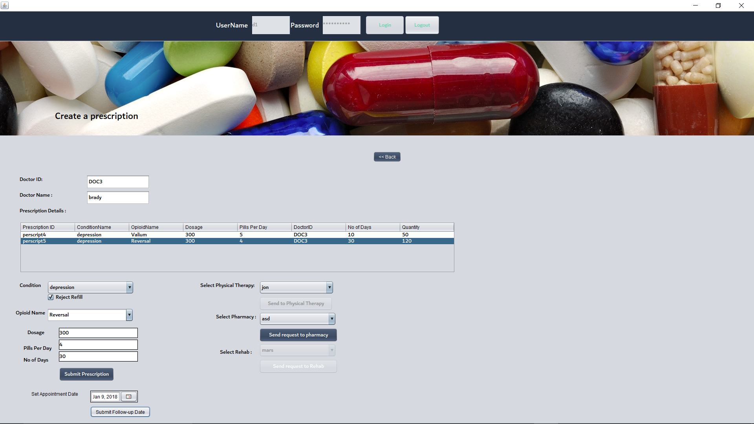
Doctor rejects refill and prescribes reversal

Slide 23
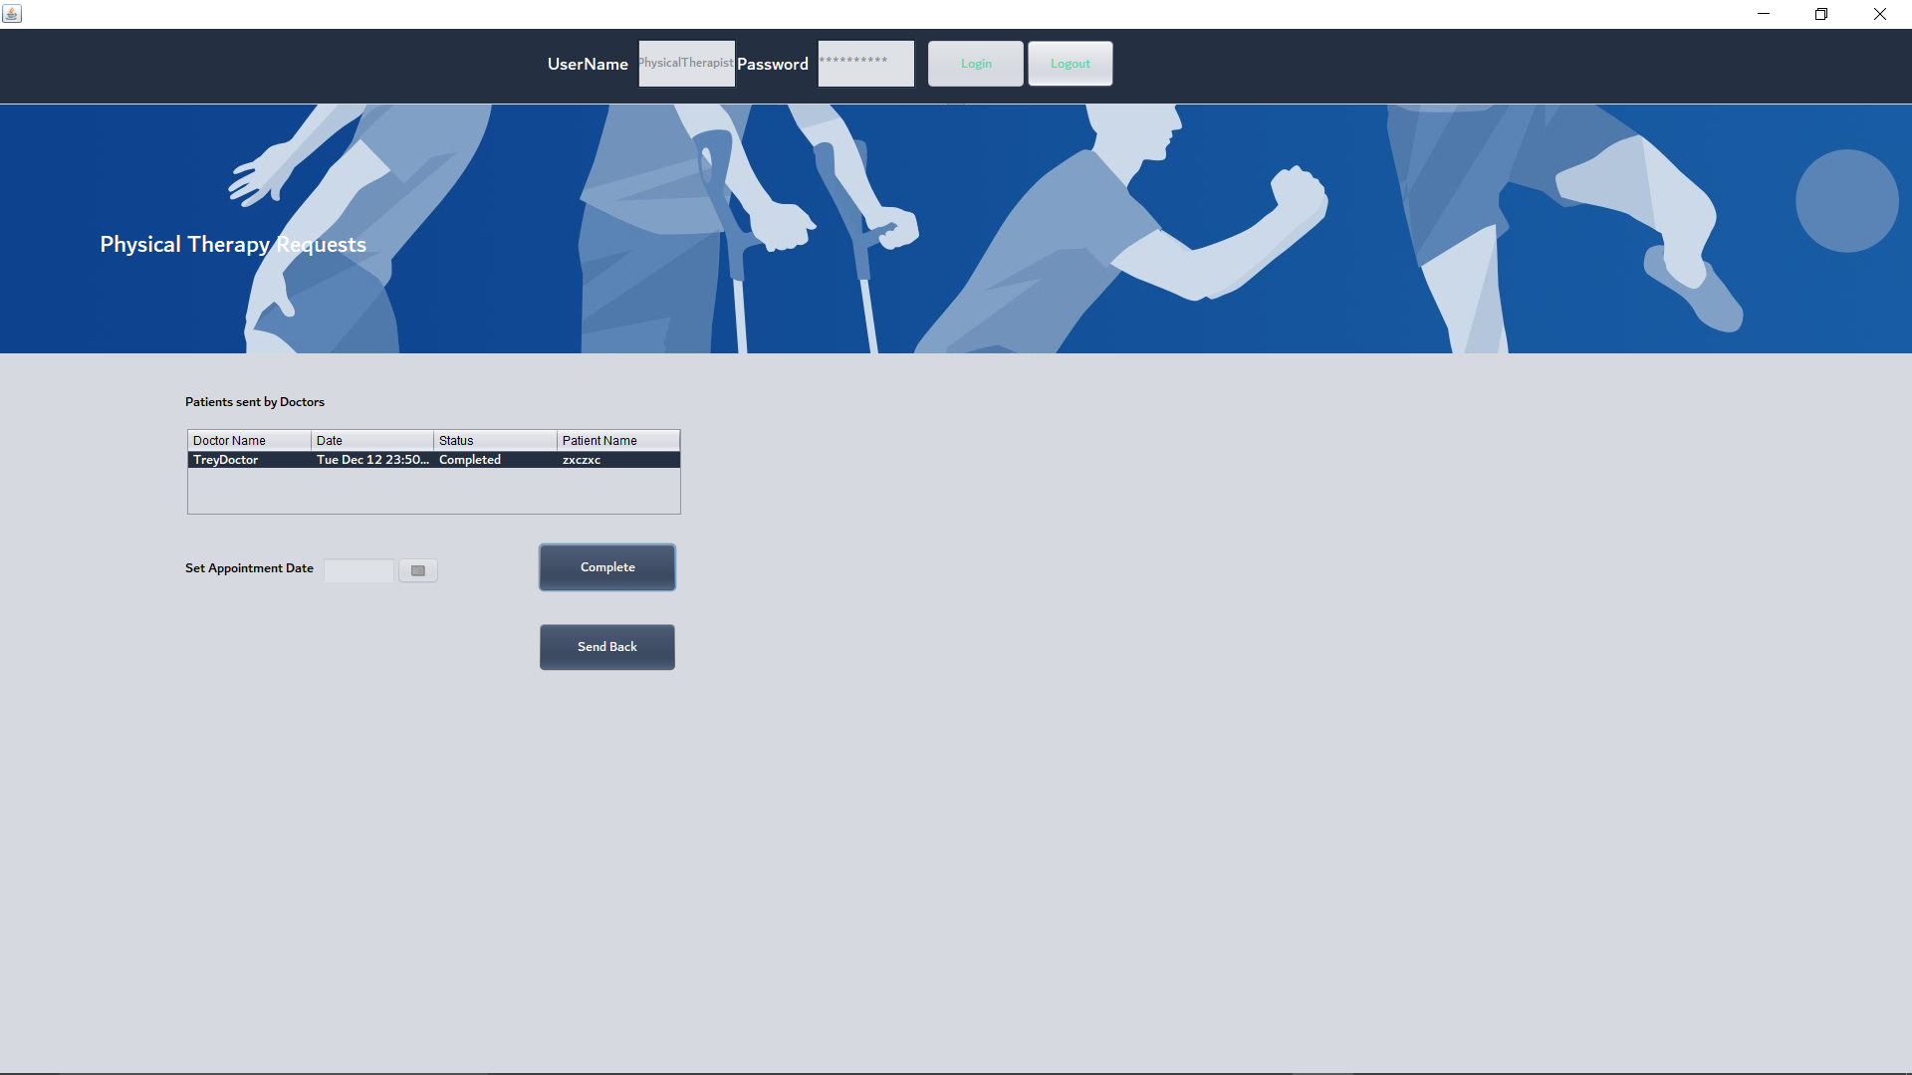
Physical Therapists can view and take action on patients sent from doctor

Slide 24
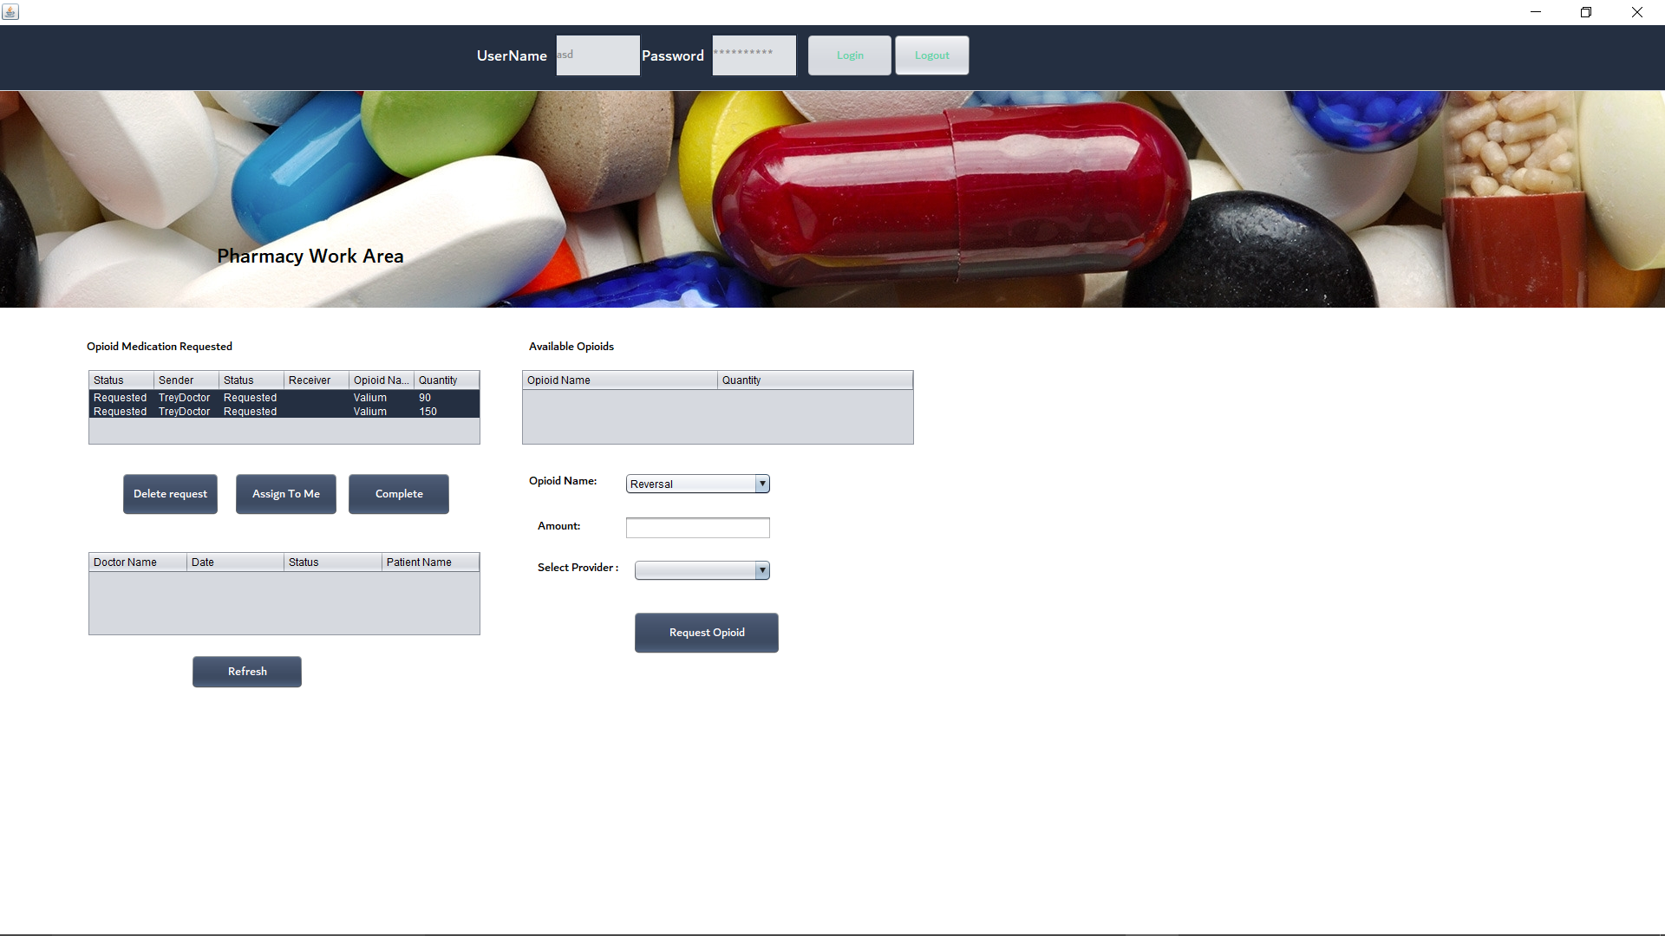
Pharmacy sees list of prescriptions sent from doctor and can request from selected provider

Slide 25
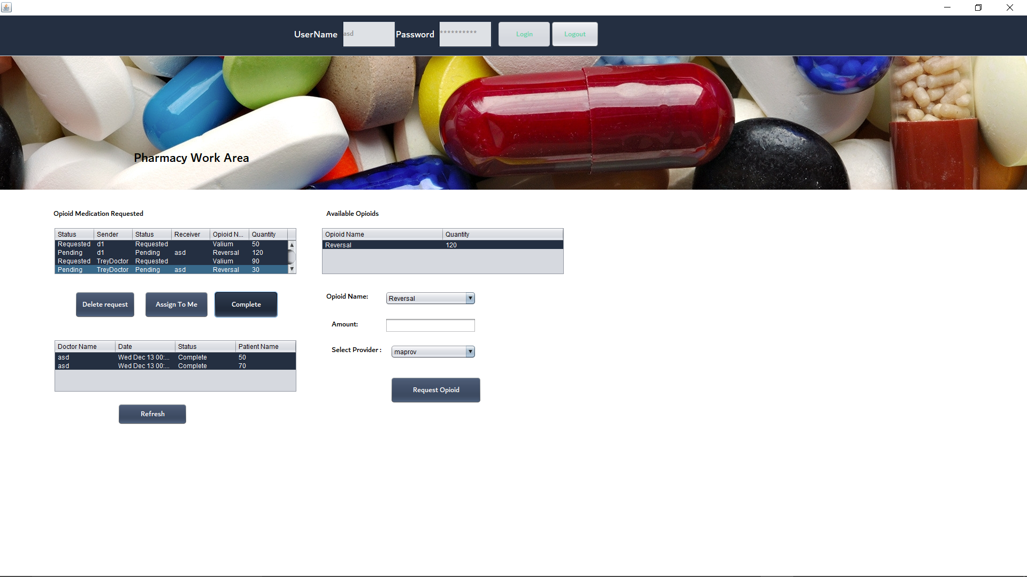
Pharmacy completes request and sends confirmation email to patient

Slide 26
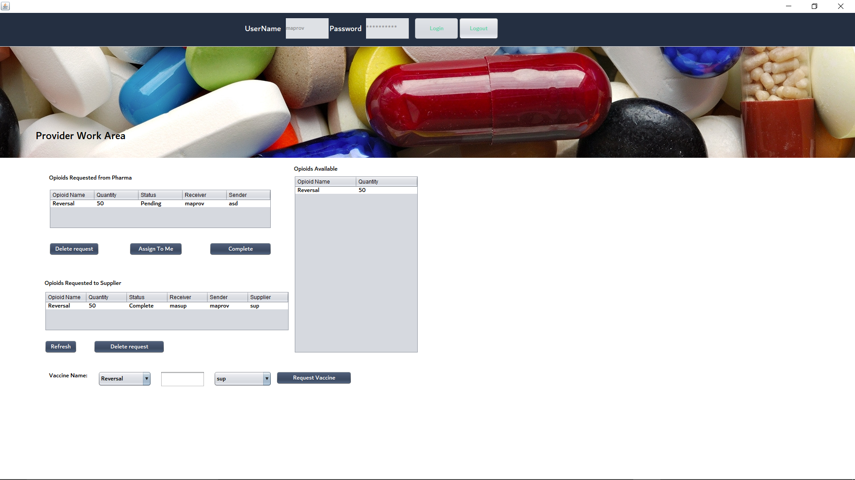
Provider views opioid and requests to supplier

Slide 27
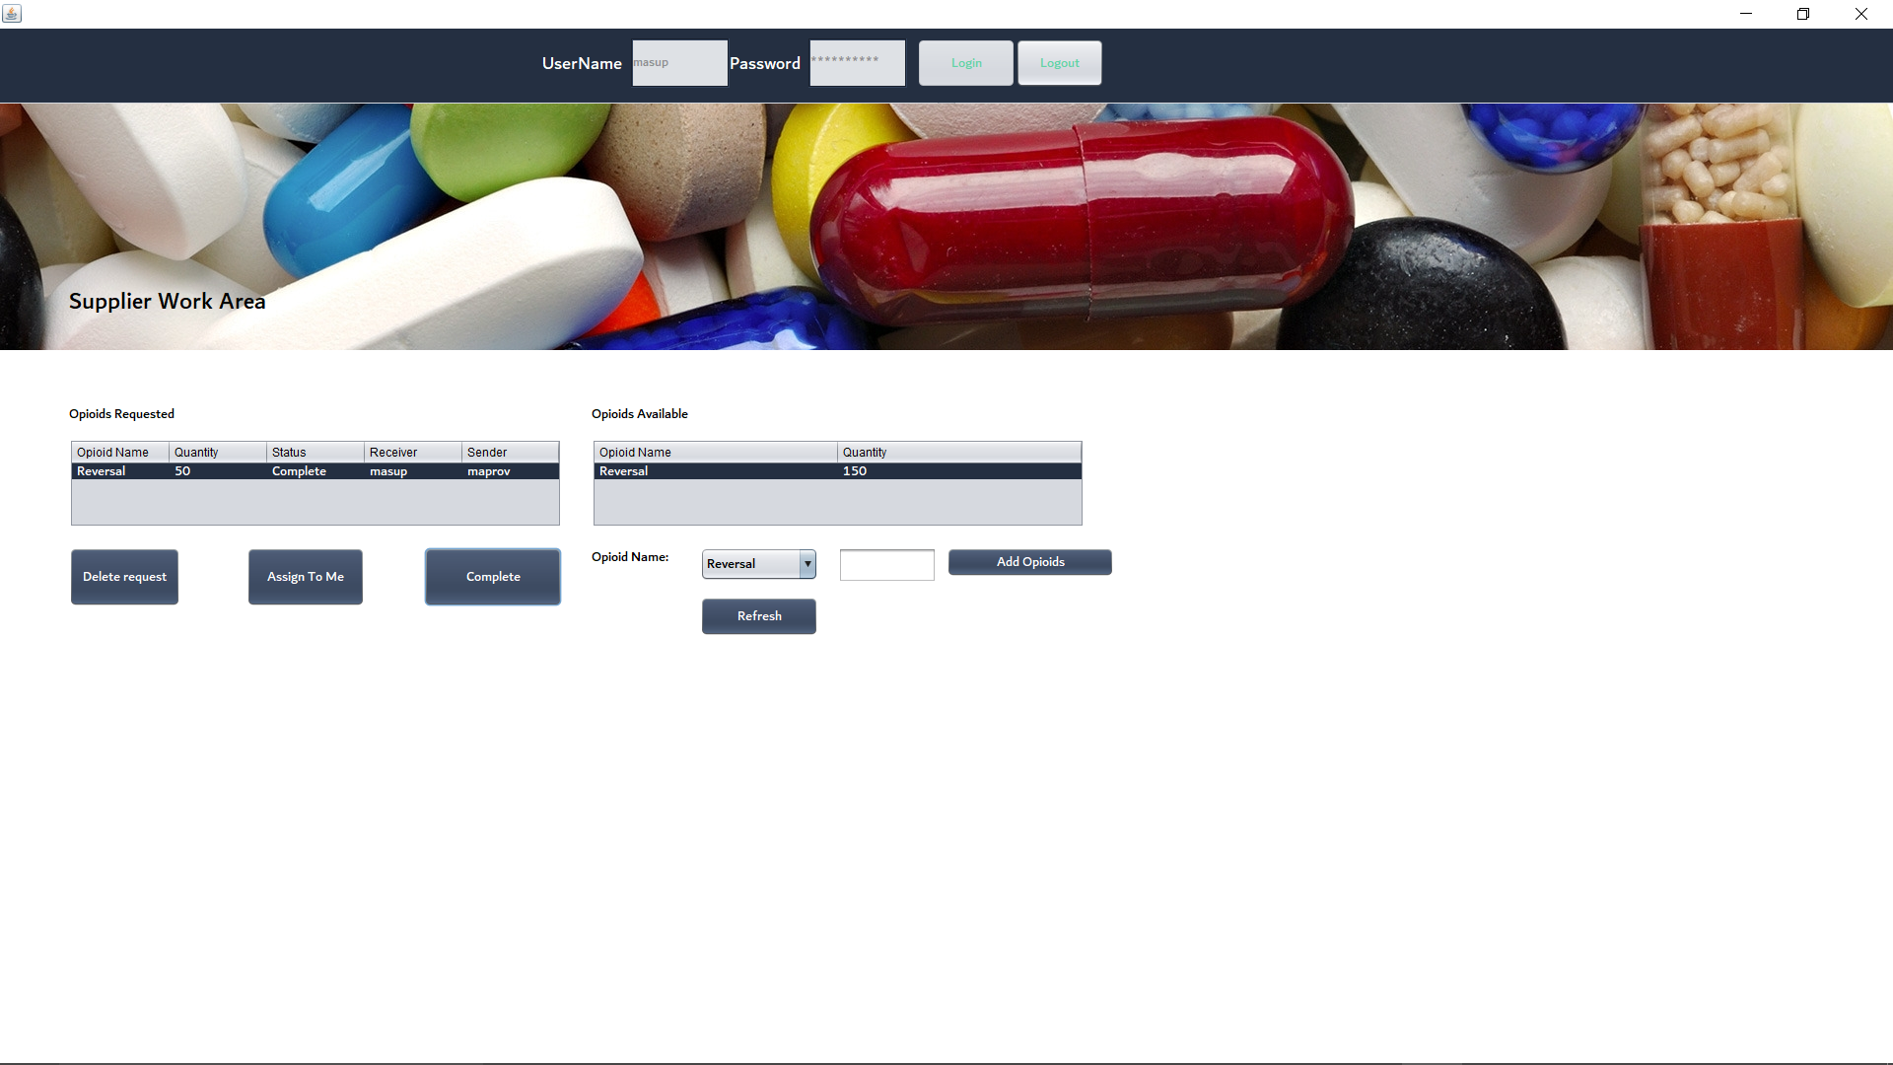
Supplier Completes Request

Slide 28
Future/ In progress use cases
Opioids can be banned or modified depending upon the analytical results.
Fire a doctor based on the number of violations he has committed.
Implement more functionalities with respect to patient and doctor.

